Slide 1
V-INTELLIGENCE UEBA
Preemptive Defense + Behavioral Intelligence + API Security + Code Assurance
A Four-Layer Answer for Critical-Infrastructure Defense
22nd Century Technologies Inc.
Ravindra Shukla – ravindra.shukla@tscti.com, 703-679-0117
LAYER 1 — PREEMPTIVE
LAYER 2 — BEHAVIORAL
Mathematically prove every known attack path is closed — before any traffic flows.
Continuous 1536-d behavioral trajectories with MITRE-mapped drift direction.
CONFIDENTIAL | 22nd Century Technologies | V-Intelligence UEBA — Executive Brief

Slide 2
THE STAKES
Apex Adversaries Are Already Inside Critical Infrastructure
PRC state actors walked past every commercial defense — and stayed for years.
VOLT TYPHOON · CISA AA24-038A
SALT TYPHOON · CISA AA25-239A
Mission: pre-position in U.S. energy, water, transport and comms for sabotage during crisis.
Living-off-the-Land — wmic, ntdsutil, netsh, rundll32. No malware, no signatures, no IOCs.
Every tool used is a legitimate Windows binary.
5+ YEARS undetected dwell in U.S. critical infrastructure.
Mission: espionage at carrier scale across U.S. and allied telecom.
200+ telcos in 80+ countries; 9 U.S. carriers confirmed (AT&T, Verizon, T-Mobile).
Accessed CALEA lawful-intercept systems used for senior U.S. officials.
4+ YEARS undetected. Slow, sub-threshold, patient.
THE POLICY INFLECTION
Defense is shifting from reactive to preemptive. Gartner projects preemptive cybersecurity will grow from <5% of security spending in 2024 to 50% by 2030. Yet 99% of firewall breaches are still misconfiguration, and threshold-based detection never fires on slow, credential-borne intrusions.
The structural lesson of Volt + Salt Typhoon: we must prove the door is closed — and watch the room for what slips through. Neither layer alone is sufficient.
Years of undetected access vs. immediate identification — the gap is operational, not theoretical.
CONFIDENTIAL | 22nd Century Technologies | V-Intelligence UEBA — Executive Brief

Slide 3
THE GAP
Why Current Tooling Cannot Close It
Two structural gaps — one in prevention, one in detection.
PREVENTION FAILS
DETECTION FAILS
Pentests sample; they never prove. Point-in-time and incomplete.
ASM sees what exists, not what is reachable.
Config review is manual — stale within hours.
The rule state space is too large to sample adequately.
KEV patching covers only ~20% of attacks.
Threshold UEBA: LoTL never crosses a fixed line.
Sigma rules: adversaries retool faster than rules ship.
Per-source silos: one attacker looks like 10 users.
"87% anomalous" — anomalous HOW? No direction.
Only point-in-time snapshots — no trajectory.
WHAT THE ADVERSARY EXPLOITS
Configuration gaps no one has PROVEN are closed
Both Typhoons enter via unpatched / misconfigured edge devices
Valid credentials indistinguishable from legitimate use
Stolen creds pass every config-based check by design
Living-off-the-Land tools allowed by policy
wmic / ntdsutil / netsh cannot be blanket-blocked
Slow drift invisible to fixed thresholds
5+ year campaigns operate below every alert threshold
Identity fragmentation hides cross-domain chains
One attacker appears as 10 unrelated identities
Result: $0 invested in tooling that could have detected either campaign before public disclosure.

Slide 4
THE ANSWER
Four Layers, One Shared Vocabulary
Preemptive shrinks the attack surface mathematically. V-Intelligence detects what remains. API security guards applications. Mythos secures the code.
LAYER 1 — PREEMPTIVE DEFENSE
LAYER 2 — V-INTELLIGENCE UEBA
Builds a formal mathematical model of every firewall, IdP, IPS, SASE and WAF and reasons exhaustively over the full configuration state space — no sampling.
Proves every known CVE path is blocked or compensated.
Catches config drift within the hour.
Complete reasoning — not probabilistic. Zero telemetry, zero agents.
"Close the door before they knock."
Embeds 5 behavioral signals (auth, process, network, file, identity) into a unified 1536-d vector per entity, per window — and tracks the trajectory.
CUSUM change-point catches slow, sub-threshold drift.
Drift direction projects onto 8 MITRE ATT&CK concepts — not "anomalous," but "drifting toward lateral_movement (T1021)."
Entity fusion unifies 10+ identity systems into one behavioral entity.
"Watch the room for what slips through."
LAYER 3 — API & APPLICATION SECURITY
LAYER 4 — CODE & SUPPLY CHAIN
Behavioral API discovery and protection. Stops bot attacks, business logic abuse, shadow API exposure. Governs AI agent-to-API traffic.
Mythos: 2,000+ zero-days in 7 weeks. 7-gate CI/CD pipeline — code, SAST, DAST, SCA, container, IaC, runtime. Vulnerable code cannot reach production.
Four layers, one shared MITRE vocabulary. Preemptive closes the door. UEBA watches the room. API security guards applications. Mythos secures the code.

Slide 5
LAYER 3 — APPLICATION / API / DATA / MICROSERVICES
API & Application Security
Discover, protect, and govern every API — before attackers find what you don’t know exists.
WHAT THE ADVERSARY EXPLOITS
22CT INNOVATION
• Shadow and undocumented APIs expose unknown attack surface
Behavioral API & Application Protection
• Business logic abuse bypasses signature-based defenses
• Automated bot attacks — credential stuffing, scraping, fraud
• Automated API discovery — finds shadow, zombie, and undocumented APIs across the environment
• API-targeted data exfiltration and injection attacks
• Behavioral bot defense — distinguishes human, bot, and AI agent traffic without CAPTCHAs or friction
• Agentic AI workflows creating ungoverned API connections
• Business logic abuse detection — identifies application workflow manipulation that WAFs miss
• Runtime API protection — real-time threat detection at the API layer, not static rules
• Agentic AI gateway — security, governance, and control for AI agent-to-API interactions
• Sensitive data exposure monitoring — flags PII and credential leakage in API responses
ACTIVE DEVICES & COMPONENTS
• OWASP API Top 10 coverage — comprehensive protection against known API attack patterns
• API gateways and load balancers
• Unified visibility — single pane across internal, external, and third-party API traffic
• Web application firewalls (WAF)
• Application servers and microservices
• Database and data-layer services
• Container orchestration (K8s)
• Service mesh and east-west traffic
APIs are the fastest-growing attack surface in federal environments. Behavioral API protection discovers what you don’t know exists, stops what signatures miss, and governs what AI agents connect to — closing the gap between network defense and application reality.
CONFIDENTIAL | 22nd Century Technologies | V-Intelligence UEBA — Executive Brief

Slide 6
LAYER 4 — CI/CD PIPELINE / SOFTWARE SUPPLY CHAIN
Code & Supply Chain Assurance
Find vulnerabilities before deployment — not after breach. Secure the code that builds the mission.
WHAT THE ADVERSARY EXPLOITS
22CT INNOVATION
• Zero-day vulnerabilities in deployed code and dependencies
Mythos + 7-Gate CI/CD Pipeline
• Compromised open-source packages (supply chain injection)
• Vulnerable container images propagating across environments
• Mythos — 2,000+ zero-day vulnerabilities discovered in 7 weeks across production codebases
• Insecure IaC templates creating misconfigurations at scale
• 7-gate automated pipeline — code, SAST, DAST, SCA, container, IaC, and runtime gates
• Adversary-inserted backdoors in third-party libraries
• Every gate enforces pass/fail policy — vulnerable code cannot reach production
• Supply chain dependency analysis — identifies compromised or abandoned packages
• Container image scanning — catches vulnerabilities before images enter the registry
• IaC security validation — prevents misconfigurations from deploying as infrastructure
ACTIVE DEVICES & COMPONENTS
• Continuous runtime monitoring — detects drift between deployed code and approved baseline
• Source code repositories (Git)
• SBOM generation and tracking — complete software bill of materials for every release
• CI/CD build and deploy pipelines
• Package registries and dependency managers
• Container image registries
• Infrastructure-as-Code templates
• Runtime application environments
Supply chain attacks (SolarWinds, Log4Shell, XZ Utils) prove that perimeter and behavioral defense alone are insufficient. Mythos + 7-gate CI/CD catches what enters the codebase — 2,000+ zero-days in 7 weeks — before it becomes a breach.
CONFIDENTIAL | 22nd Century Technologies | V-Intelligence UEBA — Executive Brief

Slide 7
HOW THE LAYERS WORK TOGETHER
From Perimeter to Code — Defense in Depth
Each layer catches what the others miss. Together they cover the full attack lifecycle — from network edge to codebase.
LAYER 1
LAYER 2
LAYER 3
LAYER 4
NETWORK PERIMETER
BEHAVIORAL INTELLIGENCE
APPLICATION API / DATA
CODE & SUPPLY CHAIN
Preemptive Defense
▶
V-Intelligence UEBA
▶
Behavioral API Protection
▶
Mythos + 7-Gate CI/CD Pipeline
Formal math proof. Config drift < 1 hr. Multi-vendor.
Behavioral digital twin. 4/4 nation-state attacks detected.
Discover shadow APIs. Stop bot attacks. Govern AI agents.
Secure before deploy. 2,000+ zero-days in 7 weeks.
Config Exploits Misconfiguration, Shadow Rules, Drift
Insider & APT Salt Typhoon, Volt Typhoon, LoTL
API & App Attacks Bot Fraud, Logic Abuse, Data Exfil
Supply Chain Attacks SolarWinds, Log4Shell, XZ Utils
COUNTERING AI-ENABLED CYBER ATTACKS — Innovation at every layer fights AI with AI across the full attack surface
Layer 1 proves:
Layer 2 proves:
Layer 3 proves:
Layer 4 proves:
No config gap goes unproven
No behavior goes undetected
No API goes unprotected
No vulnerable code ships
Defense in depth: Layer 1 proves the perimeter. Layer 2 watches behavior. Layer 3 guards the applications. Layer 4 secures the code. Together — no gap for adversaries to exploit.
CONFIDENTIAL | 22nd Century Technologies | V-Intelligence UEBA — Executive Brief

Slide 8
PREEMPTIVE — LAYER 1
How Preemptive Defense Closes the Door
Prove every known attack path is blocked — before any traffic flows. Three intelligence pillars, one formal model.
ATTACK INTELLIGENCE
DEFENSE INTELLIGENCE
REMEDIATION INTELLIGENCE
Ingests terabytes of CVE, CTI, IOC/IOA feeds and advisories. ML + NLP + LLMs build deep, MITRE ATT&CK-enriched attack graphs of every campaign that matters — auto-updating on each new advisory.
A symbolic model of computation of every firewall, IdP, IPS, SASE and WAF. Reasons exhaustively over the full configuration state space — no sampling. Pinpoints shadows, conflicts, weak rules and intent errors across vendors.
A guardrailed agentic-AI reasoner, grounded in each vendor's behavior, prescribes precise, risk-prioritized fixes — no new errors, no business disruption. Findings reviewed, then applied and continuously re-verified.
WHY A MODEL — NOT A SCAN
A multi-vendor firewall path spans an astronomically large configuration state space (≫2^8000). Sampling a billion paths per second for a year covers effectively 0%. A formal model instead PROVES, for every threat: does any rule combination allow this traffic? Complete coverage — no false positives, no false negatives.
No telemetry · No agents · Config-only pull · Time-to-value < 2 weeks · SaaS / on-prem / air-gapped
Gartner: 99% of firewall breaches are misconfiguration. Preemptive verification eliminates that surface mathematically.

Slide 9
PREEMPTIVE — IN PRACTICE
Coverage, Proof, and Federal Fit
One formal model answers many questions — and finds what sampling tools never will.
WHAT FORMAL VERIFICATION FINDS
ONE FORMAL MODEL → NINE USE CASES
SMB lateral-movement path shadowed by three interspersed rules — IPS / AntiVirus silently bypassed.
Two-vendor blind spot: PAN and Fortinet both allowed update traffic with no IPS inspection — an open RCE path.
Unsanctioned-app rule partially shadowed and built on an incomplete object — credential and IP exposure.
~25% of internet-facing rules carried weak or no threat inspection — proven reachable into trusted zones.
SMTP trusted→untrusted with no inspection profile — a NIST 800-53 SC-7 compliance gap, remediated same day.
• Security posture — segmentation & inspection correctness
• External attack surface — ASM compliance, formally extended
• Change management — does the change meet its intent?
• Configuration drift — vs. an approved golden baseline
• Vendor migration — pre/post security posture equivalence
• Business / regulatory / infosec compliance
• Complete preemptive defense — full TTP coverage proof
• Third-party / supply-chain risk
• Precision cyber insurance — exact risk, not heuristics
FEDERAL FIT
Maps to NIST CSF pre-attack functions (Govern · Identify · Protect), supports CISA CDM continuous assurance, and enables Policy-as-Code. Gartner projects preemptive cyber rising from <5% of security spend in 2024 to 50% by 2030.
Preemptive shrinks the attack surface to what is provably reachable. V-Intelligence then watches what remains.

Slide 10
THE CORE INSIGHT
Why Behavioral Meaning Beats Scalar Counts
The same number can mean two completely different things. Embeddings see the difference; counters never will.
TRADITIONAL TOOLS COUNT — THEY DO NOT COMPREHEND
V-INTELLIGENCE READS BEHAVIOR AS MEANING
Two users each touch 47 files this week. One reads their own team's documents; the other scans 12 departments at 2 a.m. A scalar feature sees the same number — 47. The attacker is invisible.
1. Serialize
Raw metrics become prose: "USR-042 accessed 47 restricted files across 12 departments, 68% outside normal hours."
2. Embed
EVERY TRADITIONAL METHOD HAS A FATAL FLAW
Text → a 1,536-dimensional vector that captures behavioral semantics, not just counts.
Isolation Forest
misses slow drift within normal ranges
One-Class SVM
high false positives in high dimensions
3. Five behavioral zones
Identity · Access Pattern · Data Behavior · Network Footprint · Risk Posture.
Local Outlier Factor
sensitive to feature scaling
Z-Score (|z|>3)
only catches single-feature spikes
4. Drift
Feature CUSUM
flags everyone; no semantic context
Cosine distance between consecutive weekly embeddings = the direction of behavioral change.
Scalar features see the same number. Embeddings see different meaning — that is the whole difference between 0/4 and 4/4.

Slide 11
THE INNOVATION
What No Other UEBA Does
Each technique is well-known. The innovation is the integration — and seven pieces exist nowhere else.
1. Behavioral embedding in a unified 1536-d space
2. Per-signal drift decomposition (6 vectors / 9,216-d)
Industry scores features and rules. We embed behavior into vectors — meaning, not just magnitude.
Five signals embedded individually + one composite. Tells you "AUTH drove 72% of the change."
3. CUSUM change-point on embedding trajectories
4. Drift direction projected onto MITRE ATT&CK
Sequential detection on vectors — minimax-optimal (Lorden 1971). Dwell of years collapses to days.
Not "87% anomalous" but "drifting toward lateral_movement (T1021) at 0.82." Actionable, auditable.
5. Entity fusion across 10+ identity systems
6. HMAC-chained forensic evidence
AD, Entra, Okta, AWS, K8s, EDR, VPN, PKI, TACACS+ → one entity. An attacker stops looking like 10 users.
Tamper-evident behavioral history — altering any past snapshot breaks the chain. Court-admissible.
7. ABAC trust loop with behavioral triggers
WHY IT COMPOUNDS
Detection and proportional enforcement in one system — step-up MFA to lockout in under 5 minutes.
A normal user can score high on one dimension by chance. An attacker scores high across many — embedding + trajectory + direction + fusion reinforce into one defensible signal.
No commercial UEBA combines all seven. Most have zero. This is the differentiation, not an increment.

Slide 12
HOW IT WORKS
Inside the Engine: From Telemetry to Direction
Dual embedding builds the entity; composite scoring decides who is anomalous.
THE BEHAVIORAL MATH
5-PHASE COMPOSITE SCORING
A. Embed — 5 signal summaries → text-embedding-3-small → 1536-d behavioral state per window.
B. Drift — drift(t) = 1 − cos(V_t, V_baseline). Healthy ~0.02–0.05; compromised 0.06–0.15.
C. CUSUM — S(t) = max(0, S(t−1) + drift − μ − k). Alarm at 4σ. Accumulates sub-threshold drift.
D. Direction — proj(c) = cos(V_t − V_baseline, concept_c) over 8 MITRE concepts → top-3 + technique IDs.
Dual embedding: 5 individual + 1 composite = 6 × 1,536 = 9,216 dims per entity, per window.
Signal strength — How far the drift exceeds the entity's own baseline.
Breadth — How many of the behavioral features moved at once.
Sustained deviation — Whether the shift persists window over window.
Context divergence — Whether it appears under multiple analytical lenses.
Novelty persistence — Whether genuinely new behaviors keep recurring.
Fused into one ranked list. No single phase catches everyone.
THE PAYOFF — SEMANTIC SPACE SEPARATES WHAT FEATURE SPACE HIDES
In feature space the four stealth attackers sit inside the normal band — undetectable. In V-Intelligence's semantic embedding space, all four separate from the population. Composite scoring then ranks them: insider #2, slow APT #7, Volt Typhoon LoTL #24, Salt Typhoon #1 — all at 8.5% false-positive, where traditional methods caught zero.
V-Intelligence builds the digital entity. Composite scoring detects the anomaly. Direction makes it actionable.

Slide 13
THE PROOF
Four Stealth Campaigns, Four Different Tells
No single method catches them all. Composite scoring catches each on the phase that exposes it — 250 entities, blind.
USR-156
USR-234
USR-042
USR-118
Insider Threat · 8-month
Slow APT · 180-day
Volt Typhoon LoTL · 115-day
Salt Typhoon Telecom · 100-day
Rank #2 / 250
Rank #7 / 250
Rank #24 / 250
Rank #1 / 250
Tell: Signal Strength 30 + Breadth 19
Tell: Novelty Persistence 13
Tell: Breadth 11
Tell: Sustained 9.6 + Context 7.9
Strong, broad, sustained escalation across many features.
Low magnitude, but novel C2 destinations recur week after week.
Living-off-the-Land creates breadth, not magnitude.
Max z-score 1.71 — invisible to thresholds — ranked #1 of 250.
THE DISCRIMINATION MARGIN
TIME-TO-DETECT — INSIDER (USR-156)
Normal users — average composite 6.6, max 21.5.
Attackers — lowest 13.7, average 32.7.
The gap between the strongest normal user and the weakest attacker is clean separation no single method achieves.
Isolation Forest / SVM / LOF / Z-Score: NEVER ALERT.
V-Intelligence + composite: flags in Week 8 — before data-access escalation.
Direction tracked: baseline → off-hours access → cross-dept scope creep → data staging + exfiltration.
4 / 4 detected at 8.5% false-positive — versus 0 / 4 traditional and 1 / 4 z-score. Earlier detection = smaller blast radius.

Slide 14
THE PATH FORWARD
Proven Foundation, National Relevance, Four-Layer Defense
A capability built on a fielded model — and a conversation worth having.
PROVEN
NATIONAL RELEVANCE
WHERE R STREET FITS
Behavioral trajectory engine fielded at DLA on the Entity Digital Model (500+ entities, CUSUM, 5 signals).
Same architecture, retargeted to cyber UEBA.
4 / 4 stealth campaigns detected at 8.5% FP in blind test.
Explainable: WHAT is happening, WHERE it lives, WHO else is affected.
Directly counters the Volt + Salt Typhoon playbook the nation is now contending with.
Aligns with the preemptive-defense shift (Gartner: 50% by 2030).
Deployable across IL5 / IL6 / JWICS; local model option for air-gapped enclaves.
No PII in embeddings — privacy-preserving by design.
Independent perspective on the preemptive + behavioral framing for critical-infrastructure policy.
Thought-leadership on closing the LoTL / valid-account detection gap.
A grounded reference case for the reactive-to-preemptive transition.
Explore: briefing, joint commentary, or validation dialogue.
Preemptive closes the door. V-Intelligence watches the room. Together: detect behavioral shifts hours before IOCs fire — explain what is happening, act proportionally.

Slide 15
Appendix

Slide 16
Same four stealth attacks. Three tools, three verdicts.
Inside authorized access, the most dangerous threats never trip a threshold — so most tools miss them, or bury the signal in false alarms.
TRADITIONAL SIEM
INTERMEDIATE
V-INTELLIGENCE
point-anomaly tools
statistical z-score
behavioral entities
Isolation Forest / SVM / LOF
Flags the biggest outliers
Cohort + drift + known-bad
fused into one ranked score
Scores each user vs a threshold
>
Catches 1 of 4
>
0 of 4 caught
…and alarms on nearly everyone
no threat context
4 of 4 caught
Why it matters
The tools most agencies run today see all four attackers as normal employees. V-Intelligence catches every one — and names why.
CONFIDENTIAL | 22nd Century Technologies | V-Intelligence UEBA — Executive Brief
1

Slide 17
Same logs, read as living behavioral entities
No new data. The identical security logs become connected, time-aware entities that reveal where a user is heading — not just what crossed a line today.
SAME LOGS
BEHAVIORAL TWIN
DETECTION
no new data needed
same logs, in context
one ranked verdict
Sign-in & access logs
Tracked over time (drift)
Behavioral risk score
Network & endpoint records
>
Compared to its cohort (peers)
>
+ named technique evidence
User & device context
Matched to known-bad profiles
Calibrated, auditable
Explained in plain language
Catches low-and-slow attacks
Key point
Same data, a richer model — it captures what a user HAS done plus where they’re HEADING.
CONFIDENTIAL | 22nd Century Technologies | V-Intelligence UEBA — Executive Brief
2

Slide 18
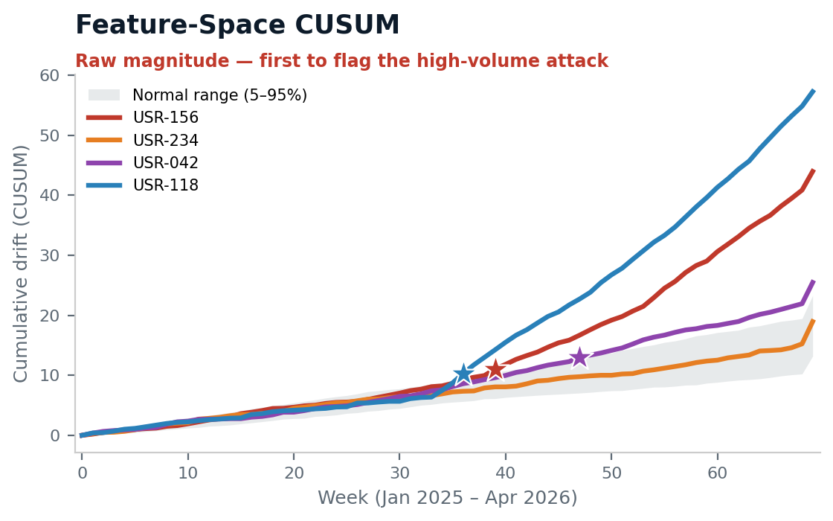
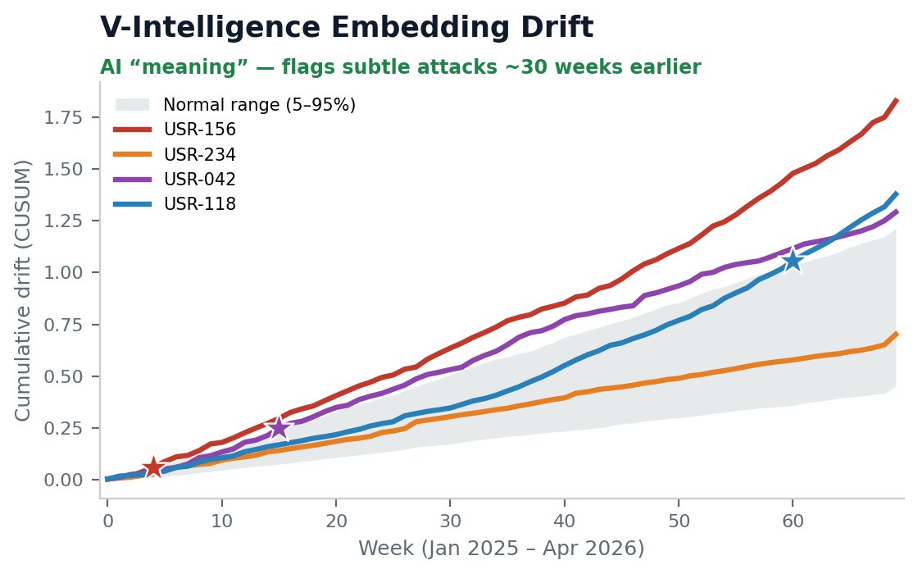
On any given day, the attacker looks normal
Two lenses read the same logs: raw numbers catch the noisy attack first; the AI “meaning” lens catches the subtle ones ~30 weeks sooner. The stealth APT hides from both on drift alone — which is why we fuse multiple fronts.
First clear detection (★): USR-118 wk 36 · USR-156 wk 4 · USR-042 wk 15 · USR-234 — caught by known-bad profile, not drift
Each lens has a blind spot. Running them together — plus the cohort and known-bad fronts — is what catches all four.
CONFIDENTIAL | 22nd Century Technologies | V-Intelligence UEBA — Executive Brief
3

Slide 19
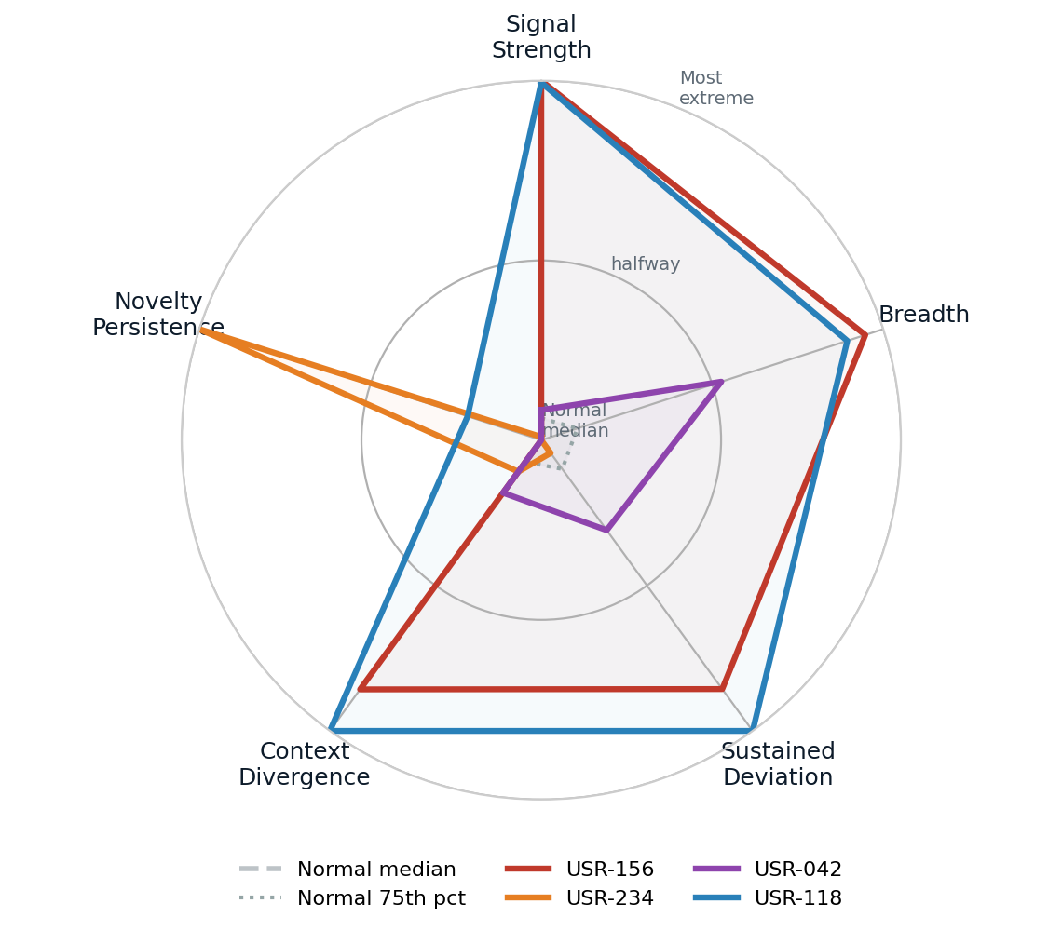
No normal user is extreme on every front at once
Each attacker pushes past the normal cluster on a different behavioral phase. That multi-phase extremity is the fingerprint a single threshold can’t see.
Grey = normal users (median & 75th percentile): a tight cluster near the center.
The five behavioral phases:
• Signal Strength — how far behavior departs from peers
• Breadth — how many behaviors shifted at once
• Sustained Deviation — how long the shift persisted
• Context Divergence — how unlike its role-group it became
• Novelty Persistence — new connections (e.g., C2) that keep recurring
USR-156 dominates Signal Strength & Breadth; USR-234 spikes on Novelty Persistence (its C2 beacon). No normal user reaches these extremes on multiple phases at once.
CONFIDENTIAL | 22nd Century Technologies | V-Intelligence UEBA — Executive Brief
4

Slide 20
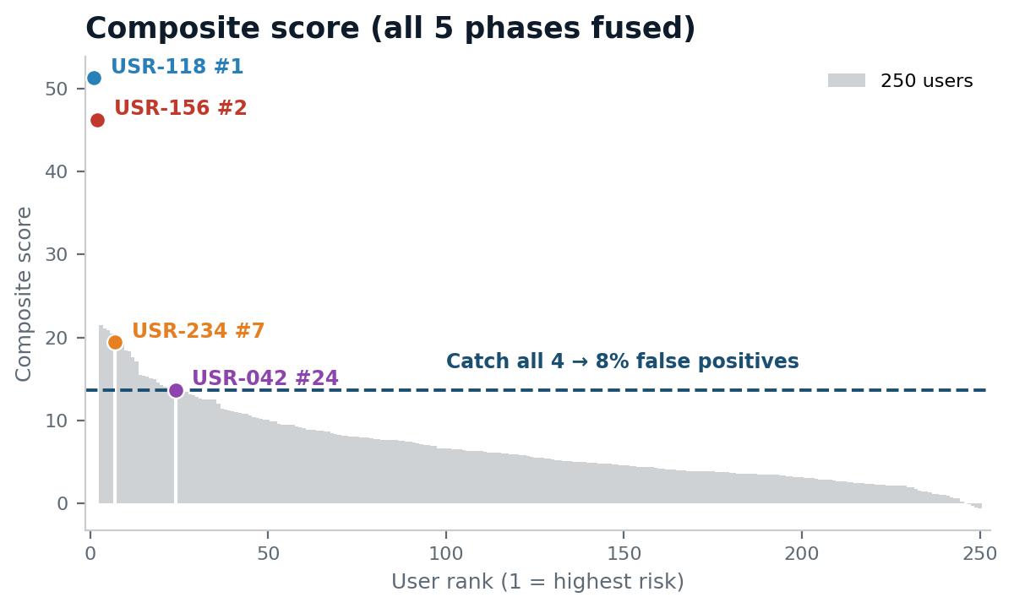
Every attack caught — with the cost stated honestly
Fused into one score, all four campaigns rank above the line that catches all four. A complementary known-bad detector catches the same four at zero false positives.
0 → 4 of 4
stealth attacks caught that legacy scored as normal
• Known-bad profiles: 4 of 4 at 0 false positives
• Composite ranking: 4 of 4 at ~8% false positives
• Subtle attacks flagged up to ~30 weeks earlier
• Every alert names the behavior that fired — auditable
CONFIDENTIAL | 22nd Century Technologies | V-Intelligence UEBA — Executive Brief
5

Slide 21
What this enables for the mission
From a daily flood of alerts to one ranked, explainable verdict — on the logs you already collect.
Triage by risk — one risk-ranked list of entities, not thousands of threshold alerts.
Explainable verdicts — every flag names the behavior, mapped to MITRE ATT&CK.
Slow-and-low coverage — catches insiders and APTs that stay inside every threshold for months.
Deployable where you operate — containerized; runs on-premises or in an enclave.
Bottom line: catch what rules miss, before it becomes a breach — with evidence a SOC analyst and an auditor can both trust.
CONFIDENTIAL | 22nd Century Technologies | V-Intelligence UEBA — Executive Brief
6

